Slide 1









My Algebra – Solving Equations 2 Interactive Notebook
$$×$$
$$\frac{1}{2}$$
$$÷$$
$$+$$
$$−$$
$$\frac{3}{5}$$
$$7$$
Name
Class
Teacher
Term 2 Semester 1
$$5^{2}$$
$$\sqrt{9}$$

Slide 2
Contents
Glossary or Formula Page
Page
Date
Description
2

Slide 3
Tasks
24
7
30
Essential Question
Questions
Notes
Summary
6

Slide 4
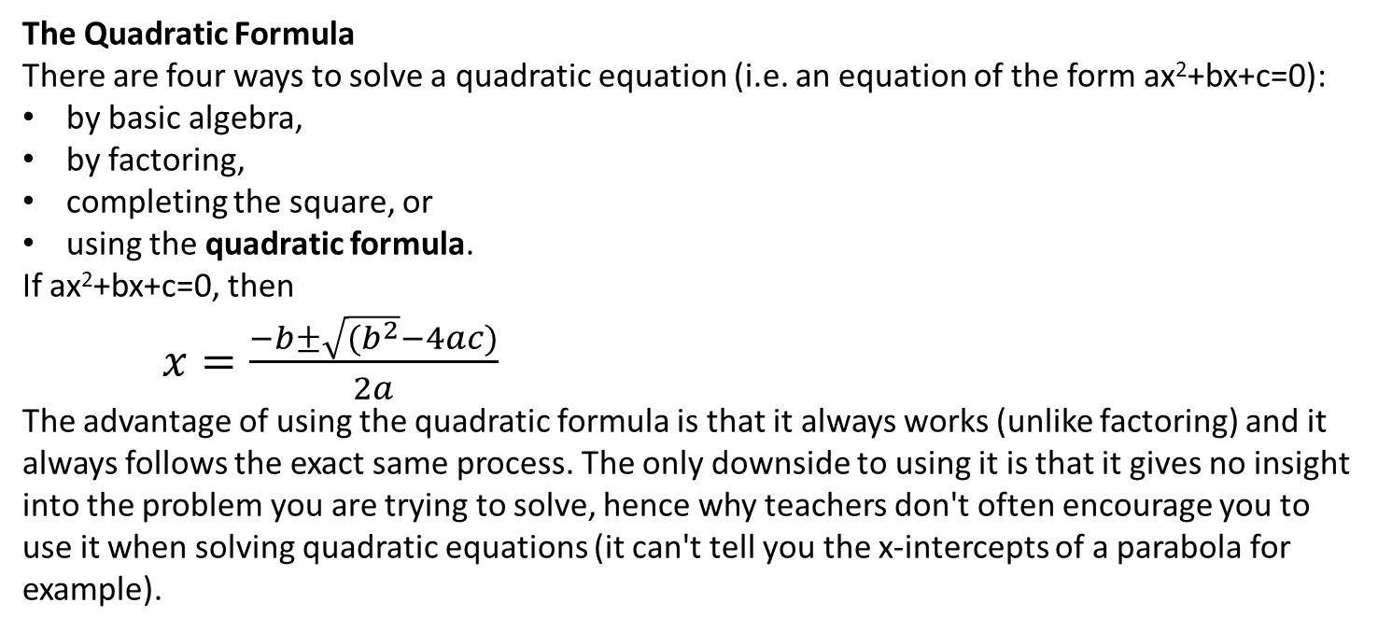
24
7
30
Date
Solving Equations?
EQ – A special Formula – The Quadratic Formula!
The Quadratic Formula
There are four ways to solve a quadratic equation (i.e. an equation of the form ax²+bx+c=0):
by basic algebra,
by factoring,
completing the square, or
using the quadratic formula.
If ax²+bx+c=0, then
$x=\frac{−b±\sqrt{{(b}^{2}}−4ac)}{2a}$
The advantage of using the quadratic formula is that it always works (unlike factoring) and it always follows the exact same process. The only downside to using it is that it gives no insight into the problem you are trying to solve, hence why teachers don't often encourage you to use it when solving quadratic equations (it can't tell you the x-intercepts of a parabola for example).

Slide 5
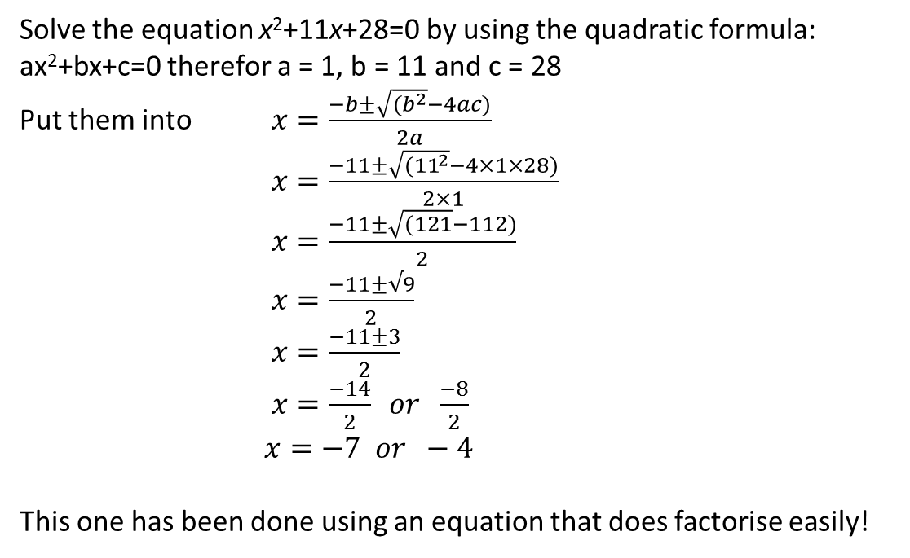
24
7
30
Date
Solving Quadratic Equations?
EQ – A special Formula – The Quadratic Formula!
Lets try it make our equation = 0!
Solve the equation x²+11x+28=0 by using the quadratic formula:
ax²+bx+c=0 therefor a = 1, b = 11 and c = 28
Put them into $x=\frac{−b±\sqrt{{(b}^{2}}−4ac)}{2a}$
$x=\frac{−11±\sqrt{{(11}^{2}}−4×1×28)}{2×1}$
$x=\frac{−11±\sqrt{(121}−112)}{2}$
$x=\frac{−11±√9}{2}$
$x=\frac{−11±3}{2}$
$x=\frac{−14}{2} or \frac{−8}{2}$
$x=−7 or −4$
This one has been done using an equation that does factorise easily!

Slide 6
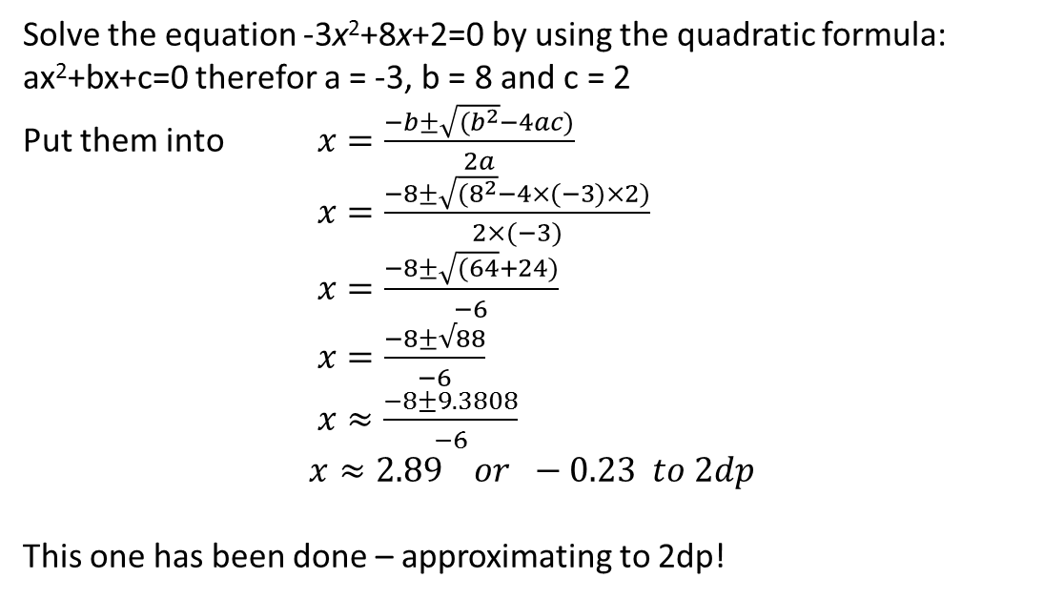
24
7
30
Date
Solving Quadratic Equations?
EQ – A special Formula – The Quadratic Formula!
Lets have another try!
Solve the equation -3x²+8x+2=0 by using the quadratic formula:
ax²+bx+c=0 therefor a = -3, b = 8 and c = 2
Put them into $x=\frac{−b±\sqrt{{(b}^{2}}−4ac)}{2a}$
$x=\frac{−8±\sqrt{{(8}^{2}}−4×(−3)×2)}{2×(−3)}$
$x=\frac{−8±\sqrt{(64}+24)}{−6}$
$x=\frac{−8±√88}{−6}$
$x≈\frac{−8±9.3808}{−6}$
$x≈2.89 or −0.23 to 2dp$
This one has been done – approximating to 2dp!

Slide 7
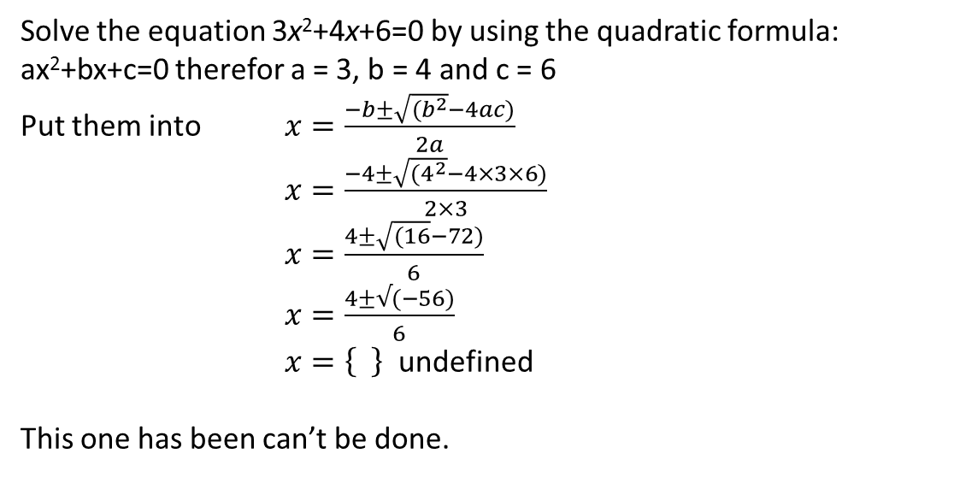
24
7
30
Date
Solving Quadratic Equations?
EQ – A special Formula – The Quadratic Formula!
Lets have another try!
Solve the equation 3x²+4x+6=0 by using the quadratic formula:
ax²+bx+c=0 therefor a = 3, b = 4 and c = 6
Put them into $x=\frac{−b±\sqrt{{(b}^{2}}−4ac)}{2a}$
$x=\frac{−4±\sqrt{{(4}^{2}}−4×3×6)}{2×3}$
$x=\frac{4±\sqrt{(16}−72)}{6}$
$x=\frac{4±√(−56)}{6}$
$x=\left\{ \right\}$ undefined
This one has been can’t be done.
We can’t find the square root of a negative number so this equation can’t be solved.

Slide 8
Exercises
Exercises 7.6 & 7.7 from Dwyer
All to be done with a smile on your faces.

Slide 9
Notes Review
24, 7 ,30
Date
Title
Essential question
Notes complete
Notes complete with colour and diagrams
Questions completed
Contents page filed in
Formula page filled in

Slide 10
Homework
Review your notes and write a summary answering the essential question.

